Slide 1

osint (open-source intelligence) & Passive reconnaissance
Aqeeb Hussain
Offensive Security Tactics for Linux Professionals

Slide 2

Agenda
Topic One: Email/Domain Harvesting with theHarvester/Phonebook.cz
Topic Two: BGP ASN/Host Enumeration with Netcraft
Topic Three: Internet Archiving with The Wayback Machine
Topic Four: Google Dorking with GHDB (Google Hacking Database)
Topic Five: Breached Credentials

Slide 3

What is OSINT?
A methodology involving the use of public data/OSINT tools to gather information against a target.
OSINT can target people/organizations
OSINT is the first step an adversary would take in order to gather information against a target.
OSINT is a completely passive process (No direct interaction or link to the target)
Notes:
So OSINT itself is a set of steps which can be used by an attacker to gain information using public resources. OSINT can be done in two different approaches which can involve person based OSINT or organisational based OSINT.
Person based OSINT is very up close and personal to a target. It involves gaining personal information on our target such as family members, place of work, home address, date of birth and any user accounts which they may have belonging to them.
In our case, we will be focusing more on organisational based OSINT.

Slide 4
OSINT Tools
theHarvester
Phonebook.cz
Netcraft
The Wayback Machine
Google Dorks
BreachDirectory API
Dehashed
Notes:
As part of OSINT, using tools can be a common practice. You are not in a restricted environment where you risk detection provided you make zero direct contact with your target i.e. Emails, phone calls alerting target employees to your presence. OSINT can involve several automation tools, useful APIs and websites which can provide relevant and useful information. I’ll be discussing each tool mentioned on this slide in more detail as the output from these tools & sites can determine the strength of your passive reconnaissance phase.
The next tool which is a lot more useful when targeting an organisation is theHarvester. TheHarvester, a tool which is written in Python is capable of scraping the internet and querying various search engines such as Google, Bing and Yahoo in relation to a provided target domain. TheHarvester is also capable for locating email addresses which are associated to the target domain, all of this information can come useful when querying breached credential databases and attempting to gain access to target infrastructure via legacy pathways such as IMAP. TheHarvester can also be very useful in mapping the target organisations domains together, we are able to see all of the different internet facing hosts which belong to the organisation which we can attempt to query for further information later on.
Next is netcraft. Netcraft can act as a worthy source of information when conducting passive reconnaissance. Netcr

Slide 5
Topic one
Email/Domain Harvesting

Slide 6
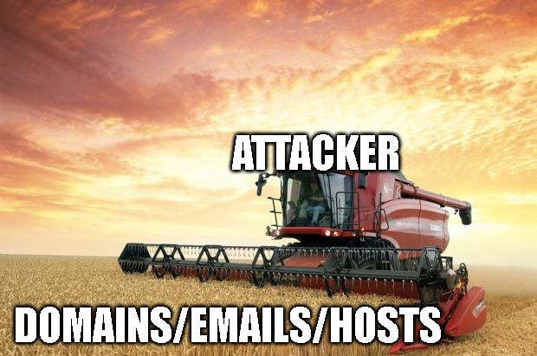
The Harvester
Written in Python, a scraping tool capable of querying the internet with multiple search engines.
Capable of gathering target domains, employee emails and target hosts
Supports passive reconnaissance (No direct communication to the target)
Notes:
Firstly introducing theHarvester: A tool which is written in Python is capable of scraping the internet and querying various search engines such as Google, Bing and Yahoo in relation to a provided target domain. You can also include LinkedIn profiles from theHarvester proving that theHarvester as an automation tool when conducting OSINT can be extremely powerful as we can use this information to determine any key employees who could be targeted in any phishing campaigns.
theHarvester is also extremely customisable. With the ability to plug this tool into many other APIs, we can extend its functionalities and we can try gaining more information on a target which would be helpful to us in the external testing phase.
TheHarvester is also capable for locating email addresses which are associated to the target domain, all of this information can come useful when querying breached credential APIs. Since we can grab any breached credentials to attempt gaining access to target infrastructure via legacy pathways such as IMAP to bypass 2FA (If IMAP is available). TheHarvester can also be very useful in mapping the target organisations domains together, we are able to see all of the different internet facing hosts which belong to the organisation which we can attempt to query for further information later on.
The best part of this as an attacker? You’re not making any interactions with the target organisation, you’re just querying the internet and information gathering. This is exactly the power of OSINT and is just the tip of the iceberg. OSINT can be used for many more operations such as finding misconfigured webpages against organisations, SSH keys if they’re on the internet, misconfigured management devices such as IDRACs which may be available through the internet, an easy way into the management network achieved by client side attack or infiltration. Some of these things will be demonstrated in these slides to prove the power of OSINT and why a trained adversary chooses OSINT before making any further advances towards the target.
theHarvester also has a sibling tool which achieves the same tasks but within a graphical environment known as Maltego. This tool is not covered in this course, but I’d encourage to explore other tools to find common trends/methods in which information is found to be able to conduct deeper OSINT. Tools in any situation can only provide information in some cases a limited amount, it is our job as adversaries to interpret this information correctly to aid our attempts to compromise the network.

Slide 7

Phonebook.cz
Internet site capable of dumping more information than theHarvester.
Capable of gathering target domains, employee emails and target hosts
Supports passive reconnaissance (No direct communication to the target)
Notes:
Next I want to introduce a site hosted from Czech Republic known as phonebook.cz
This site is able to scrape many more emails out of the internet in comparison to theHarvester. This is a tested fact from comparing results with theHarvester and phonebook.cz against employees belonging to target organisation.

Slide 8
Topic Two
BGP ASN/Host Enumeration with Netcraft
Notes:
Moving onto BGP ASNs and conducting host based enumeration using Netcraft.

Slide 9

Netcraft
Provides site reports on domains of interest.
Can act as a defensive site to determine phishing domains
Provides BGP ASN allowing us to determine delegated subnets of target organization
Available hosting history to determine installed services and operating system of target
Notes:
Netcraft is a domain reporting site which can be helpful to report information on target domains such as hosting history which involves OS type, installed services and validity of the domain.

Slide 10
Topic three
Internet Archiving with The Wayback Machine

Slide 11

The Wayback Machine
Internet archive database which we can use for querying previous pages which no longer exist
Universities support The Wayback Machine due to being a public organization and data preservation
Can be used for purposes such as viewing previously deleted PasteBin records of data breaches
Notes:
A useful resource which is overlooked can be The Wayback Machine. This is a resource which can allow viewing archived versions of webpages such as main webpages and any other webpages belonging to a target site. Using the wayback machine can help you to uncover details such as operating system versions, previous data dumps which may have been removed from sites such as PasteBin in addition to details which could prove to be useful to achieve compromise.

Slide 12
Topic Four
Google Dorking with GHDB (Google Hacking Database)

Slide 13

Google Dorks (GHDB)
Google Hacking Database armed with search filters to produce more accurate results
Operators such as: “” file, intext, inurl can be used to check for keywords in files, URLs and webpages.
OSINT use cases: SSH keys, Management IDRACs, misconfigured webpages, pastebin dumps
Notes:
A useful utility which can uncover files from organisations of different file extensions in addition to webpages which maybe indexed in search engine can be found with Google Dorking. Google dorking makes use of search operators such as inurl, intext and filetype which can uncover different kinds of information such as login portals for publicly facing network management interfaces, data dumps from pasetbin in addition to webpages which could be misconfigured by the server and made accessible to the internet uncovering internal information.

Slide 14
Topic five
Breached Credentials API

Slide 15

BreachDirectory API
Written by C++ programmer Rohan Patra, available for free limited use/paid access
Query email addresses to find plain text passwords involved in data breaches
API access allowing extensible integration into OSINT scripts.
Notes:
Next I will be talking about BreachDirectory which is an API available on the internet for free. BreachDirectory is an API which I have used in previous OSINT engagements which resulted in finding a lot of passwords on target emails. We can use this same API against target organisation email addresses to see if we can score any breached credentials and attempt initial access to the

Slide 16
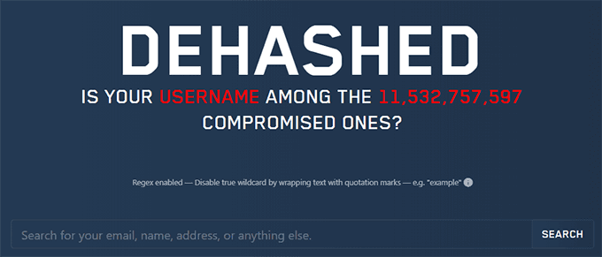
Dehashed
For the price of a quick tea/coffee it is possible to gain access to services such as Dehashed which provide hashes/plain-text credentials
Dehashed is a service which requires subscription but can provide reliable results.
For defensive operations, Dehashed can be queried for organizational breached credentials and later requested to be removed from Dehashed.

Slide 17

Questions?

Slide 18
Next Talk: Active Reconnaissance

Slide 19




Thank you
Instructor: Aqeeb Hussain
GitHub: https://github.com/aqeebhussain122/hpc-offensive-security

